Slide 1
Blood Donation Application
A help in health crises

Slide 2
Contents of this presentation
Hi, everyone here are some important points regarding our application :-
Problem statement.
How we are going to solve the problem.
Features & functions of apk.
Impact of our apk.
Technology used in building apk.
Screenshots of apk
Video of apk.
Future plans.
Team members information.

Slide 3
Problem Statement
Blood donation is a critical need, and often, there is a shortage of blood supply in emergencies. Our team aims to address this issue by developing an APK that connects blood donors and recipients in an efficient and user-friendly manner.

Slide 4
How we are going to solve the problem.
Our apk allows users to register themselves as donor and recipients, and data is being stored in google firebase database.
If user registers themselves as donor then they can see notification or emails sent by the recipients & if they had registered themselves as recipients then they can search for the donors of particular blood group.
Recipients can directly connect to the donors as mobile number, email id & address of donors will be provided to them.

Slide 5
Features & function
Users can sign up themselves as donor and recipients.
Users can Login & Logout from the apk.
Users can use function for forget password.
Users can view their profile.
Users can find the donor profile through doing registration as recipients.
Donor can find who is in need of blood by seeing the notification and email sent by recipients.
Very easy to use , time saving, recipients and donors can contact each other in less time.

Slide 6
Impact of apk
Blood donation application have several impact on society & heath-care sector :-
Significant impact on society by saving life.
Creating awareness.
Improving community health.
Building community spirit.

Slide 7
Technology used in building apk
Frontend Development – Java
Backend Development – java, google firebase
UI/UX Designing – xml.
Platform used – Android studio.

Slide 8
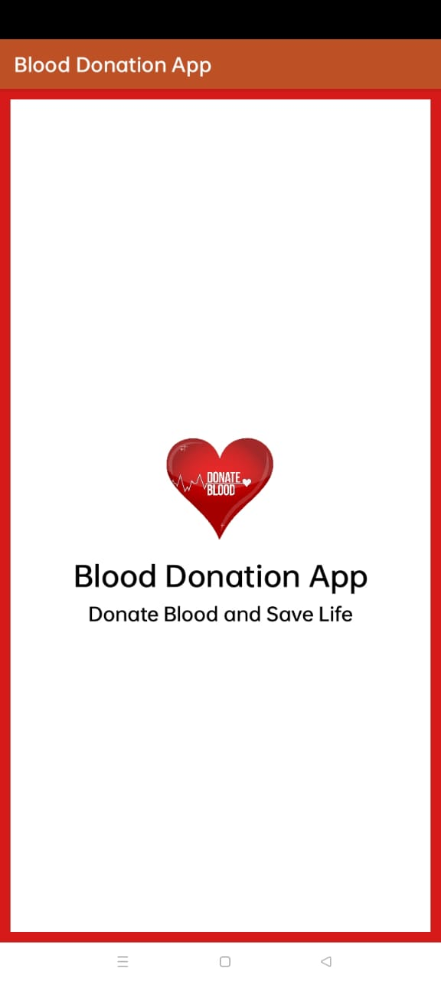
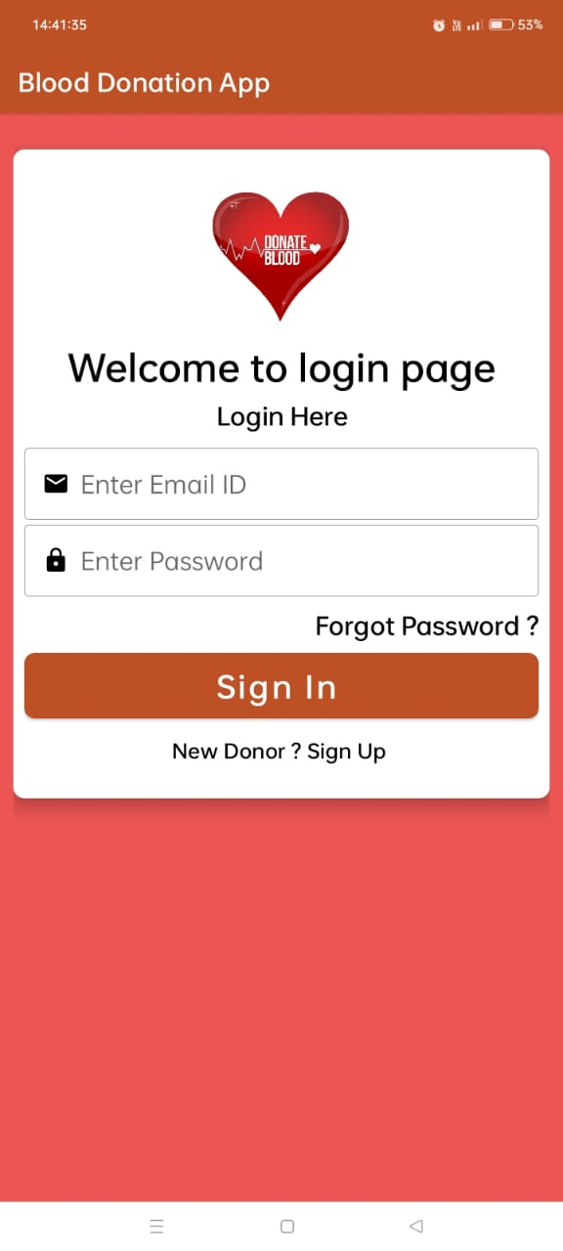
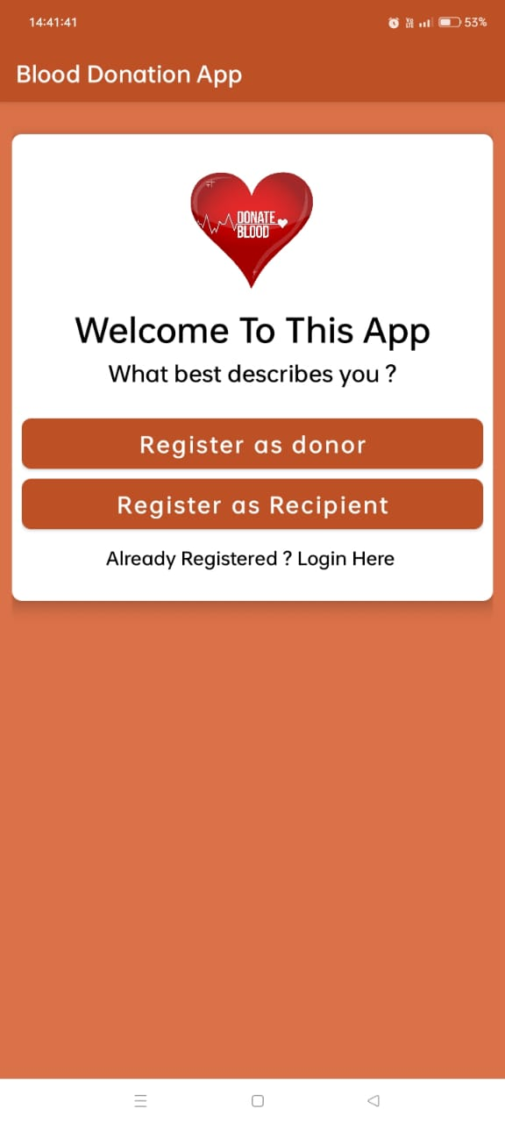
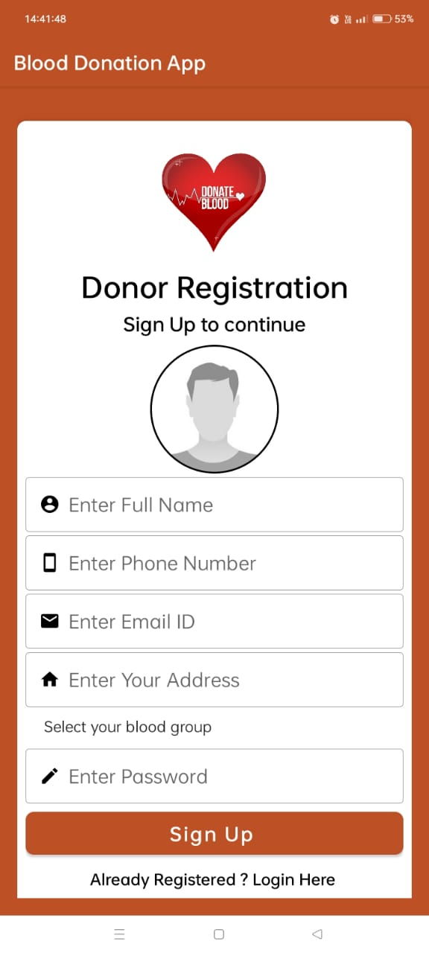
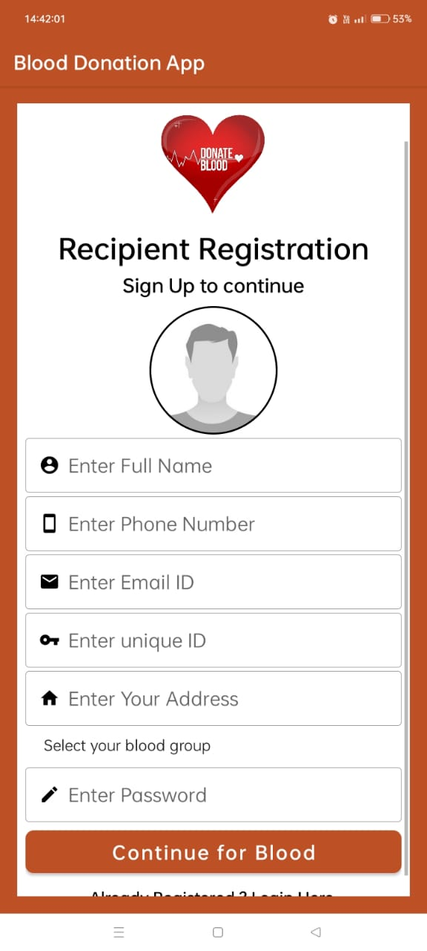
Screenshot of apk

Slide 9
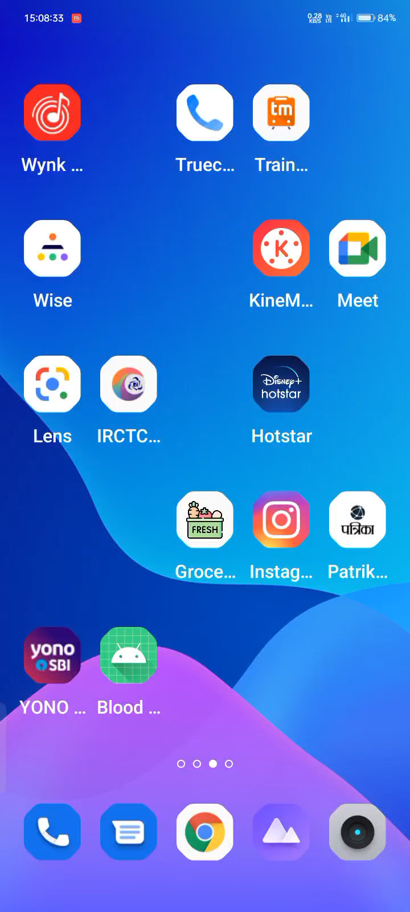
Video of apk

Slide 10
Future plans
Users can find donor of particular blood group state, area, category wise on one platform.
Users will be able to find nearby medical shops and hospitals.
Users will get notified for nearest blood donation camp.
At last our motive is two build a community for blood donors and recipients so that life can be saved.
User must not search for blood donor anywhere else rather than our application if no blood is available at hospitals.

Slide 11
Team Members
Information
Abhinav Singh
Badal Prasad Tripathi
Harshit Gupta
Anuj Paroha
Branch- Information Technology
Semester – 6th
Year – 3rd
College- GGITS

Slide 12
Thank You
From Team
Unique
GGITS

Slide 13
Alternative Resources

